Slide 1
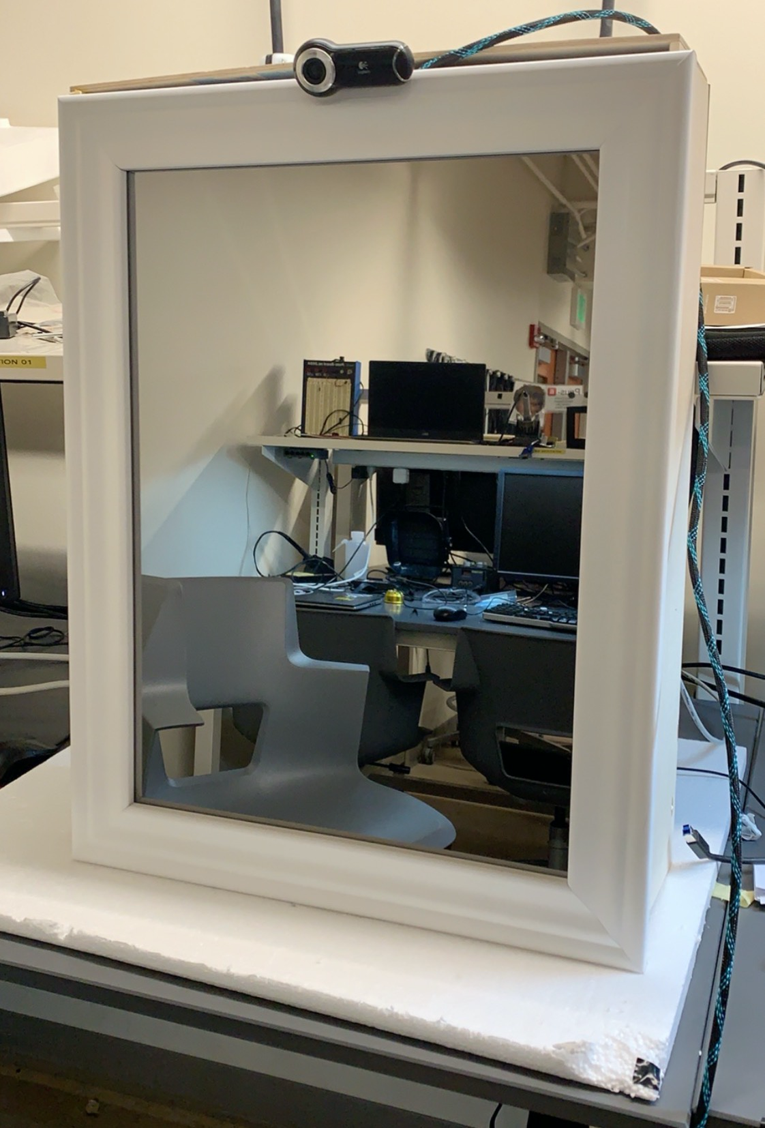
ECE 477 Final Presentation
IntelliFace
Team 1
Notes:
RSB

Slide 2
Outline
Project Overview
Block Diagram
Design Challenges
Individual Contributions:
Pratyaksh
Ishaan
Abhay
Rtvik
Project Demonstration
Notes:
RSB

Slide 3
Project Overview
An intuitive intelligent interface with an interactive UI that:
wakes up after detecting the user’s gesture
authenticates the user from a user set
presents a dashboard containing a greeting and relevant information
takes filtered photos on demand
Notes:
AS

Slide 4
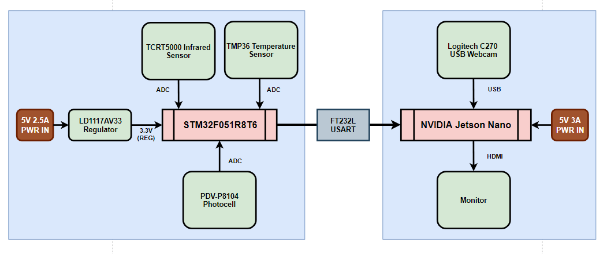
Block Diagram
Notes:
AS

Slide 5
Design Challenges
Signal noise in the temperature, brightness and IR sensor data
Shaky hands during PCB assembly
UI design, alignment and padding having a mind of its own
Module integration
Physical packaging has been taxing
Notes:
AS

Slide 6
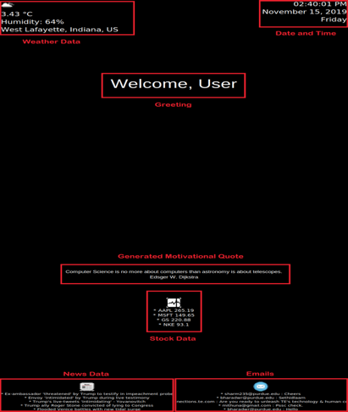
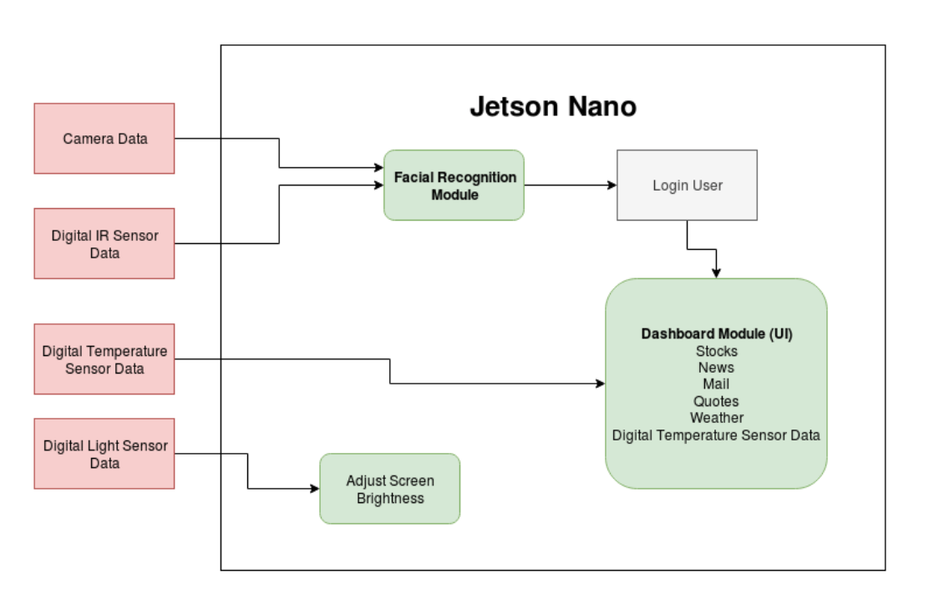
Individual Contributions: Pratyaksh
Software Design:
Designed and wrote code for the UI and Dash
Planned the workflow for the UI
Laid down the foundation for the whole system
Notes:
PS

Slide 7
Individual Contributions: Pratyaksh
Software Integration & Testing:
Helped incorporate different gesture inputs
Assisted with creating “states” for the State Machine Model
Performed thorough testing of the final prototype
Project Planning & Packaging:
Made sure that weekly goals were met (project stays on timeline)
Important to make sure we had adequate time for testing
Helped in final packaging and spray painting of the product
Notes:
PS

Slide 8
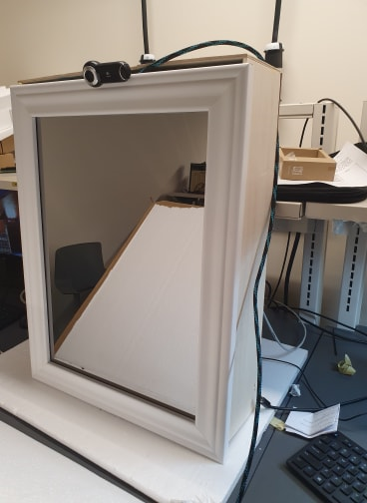
Individual Contributions: Ishaan
Microcontroller:
Programmed STM32F0 to read all the sensors attached to it namely the Temperature sensor, IR Sensor, and LDR Sensor.
Initialized the UART peripheral in STM32F0.
PCB:
Designed the physical schematic and layout for the Sensor Board.
Helped Abhay and Rtvik in soldering the PCBs.
Packaging:
Assisted in part and frame assembly .
Notes:
AS

Slide 9
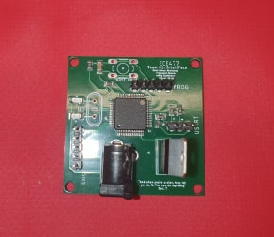
Individual Contributions: Abhay
Microcontroller:
Programmed UART peripheral on STM32F0 to communicate with Jetson
PCB:
Completed physical assembly of components and soldering of main board and sensor board
Software:
Programmed the system to recognize the different gestures
Packaging:
Assisted with woodworking in order to build the mirror chassis
Notes:
AS

Slide 10
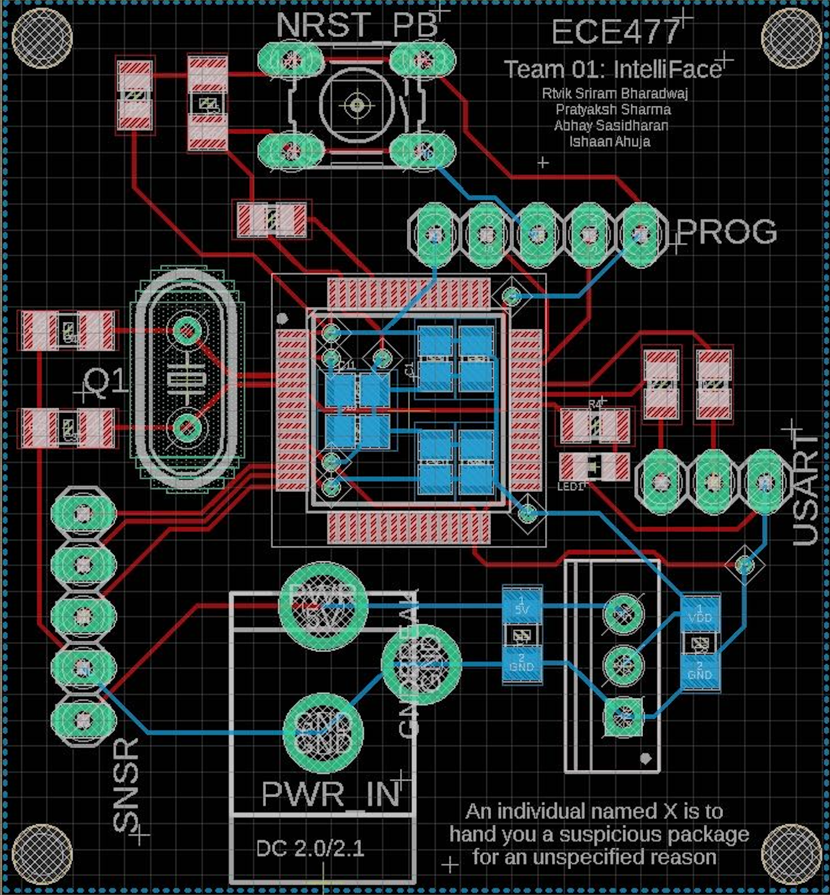
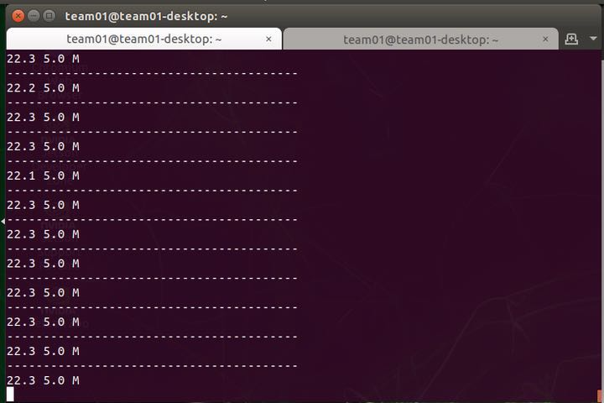
Individual Contributions: Rtvik
As the project team leader, I was responsible for team management, PCB, Facial Recognition module, software integration, physical design and construction.
PCB Design:
Primary PCB Layout and Board design
PCB Part procurement and soldering
Software and Integration:
PySerial, System Services
Timers, IRQHandlers
Slack Alert System with MirrorBot
Email, Stock, Weather APIs
Notes:
AS

Slide 11
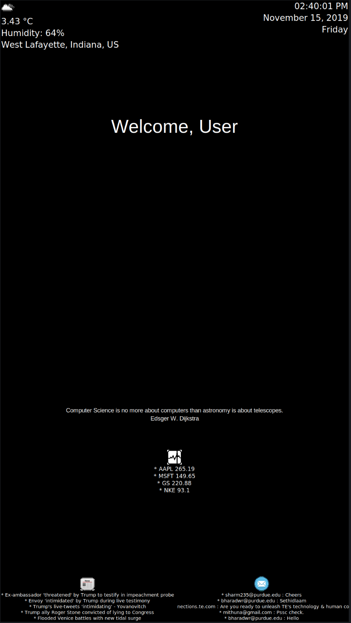
Individual Contributions: Rtvik
Physical Construction:
Design, procurement and assembly
Engraving and painting
Facial Recognition Module:
Keras Inception V3 CNN for Face ID
Webcam + Face ID Integration
Image Filter Module
Team Management:
Allocating and managing tasks using Kanban (we’re very Agile you see)
Threatening teammates periodically to complete tasks
Organizing weekly team communions to pray for a passing grade
Notes:
AS

Slide 12
Project Demonstration
An ability to successfully read ambient conditions using a temperature and light sensor using ADC and GPIO peripherals
An ability to perform user’s gesture detection using an infrared sensor on the STM32F0 using ADC
An ability to successfully communicate gesture readings, ambient light and temperature values between the STM32F0 and the Jetson Nano using USART
An ability to authenticate the user using a facial recognition API and the Jetson Nano
An ability to display metrics and relevant information (email, weather, stock tickers and news) using a dashboard on the Jetson Nano Monitor
Notes:
AS

Slide 13
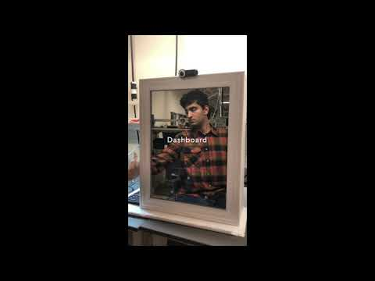
Project Demonstration
Notes:
AS

Slide 14
Questions?
Notes:
AS

